Slide 1
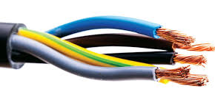
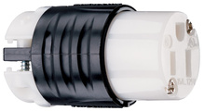
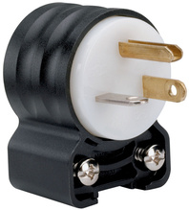
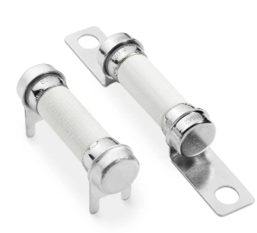
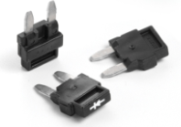
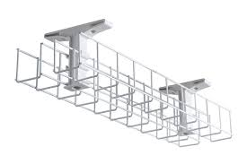
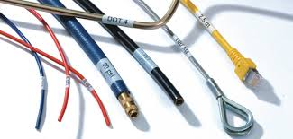
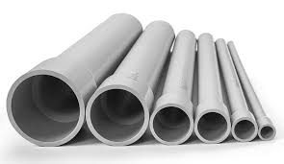
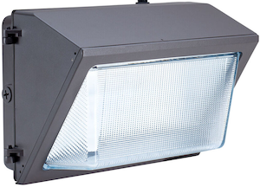
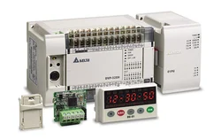
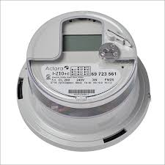
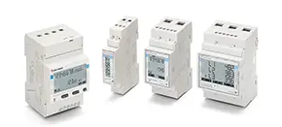
WE PROVIDE OUR CLIENTS WITH BUNDLED SOLUTIONS
Electris360 represents the top electrical products, addressing industry challenges with efficient, valuable information. With over 200 years of combined experience, our sales team provides expert advice across regions for personalized service. We offer comprehensive support in product selection, efficient communication for quick decision-making, and training on best practices to ensure long-term success.
Wire & Cable
Wiring Devices
Fuses
Copper and Aluminum Building wire, Industrial Cables, Metal-Clad, Flexible Conduit and Cord Products.
Residential, Commercial and Industrial Receptacles, Switches, Plugs and Connectors.
Power Fuses, Fuse Blocks, Elevator Disconnects, Motor Protection, and Arc Flash Relays.
Cable Tray
Cable Management
PVC
Durable, Flexible, Corrosion-Resistant Metal and Non-Metallic Cable Tray and Wire Mesh Solutions for Routing Cables.
Cable Management and Protection Products, Identification Systems and Network Connectivity Solutions.
High Durability and Chemical Resistance, Schedule 80 & 40; Used in Commercial and Residential Sectors.
Lighting
Controls
Meters
Indoor/Outdoor Lighting, Exits & Emergency, LED Lamps and Luminaires.
Manual, Time-Based, Photosensors, Dimming Systems, Networked Lighting, Wireless Control Systems.
Single Position and Multi-Position Meter Sockets, Instrument Rated Metering, Pedestals, and Tap Boxes.

Slide 2
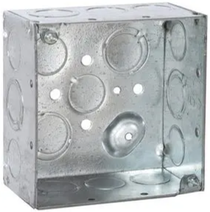
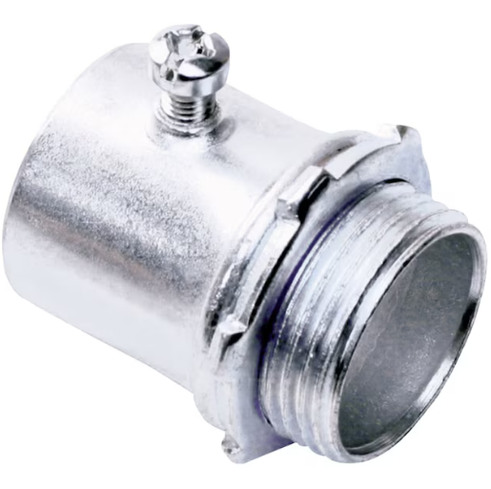
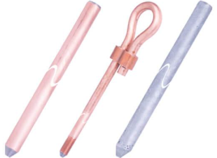
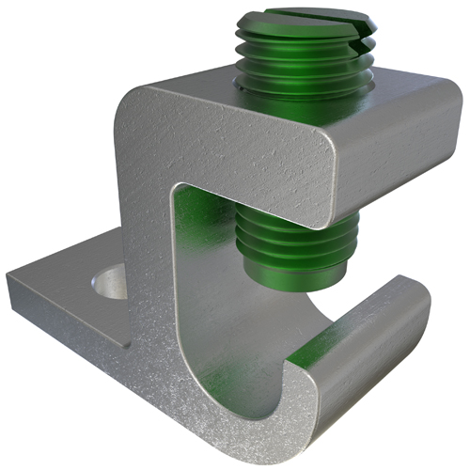
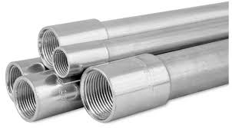
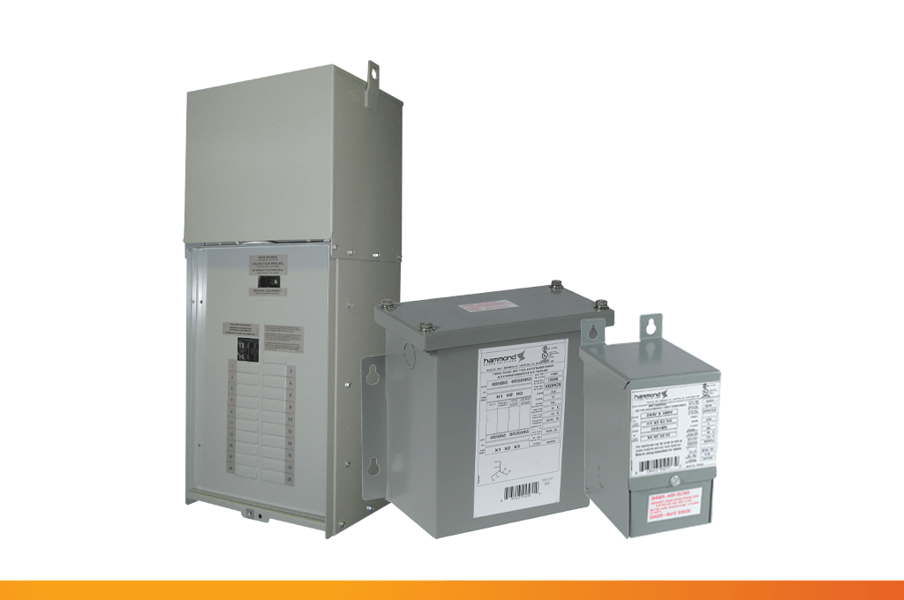
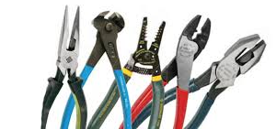
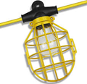
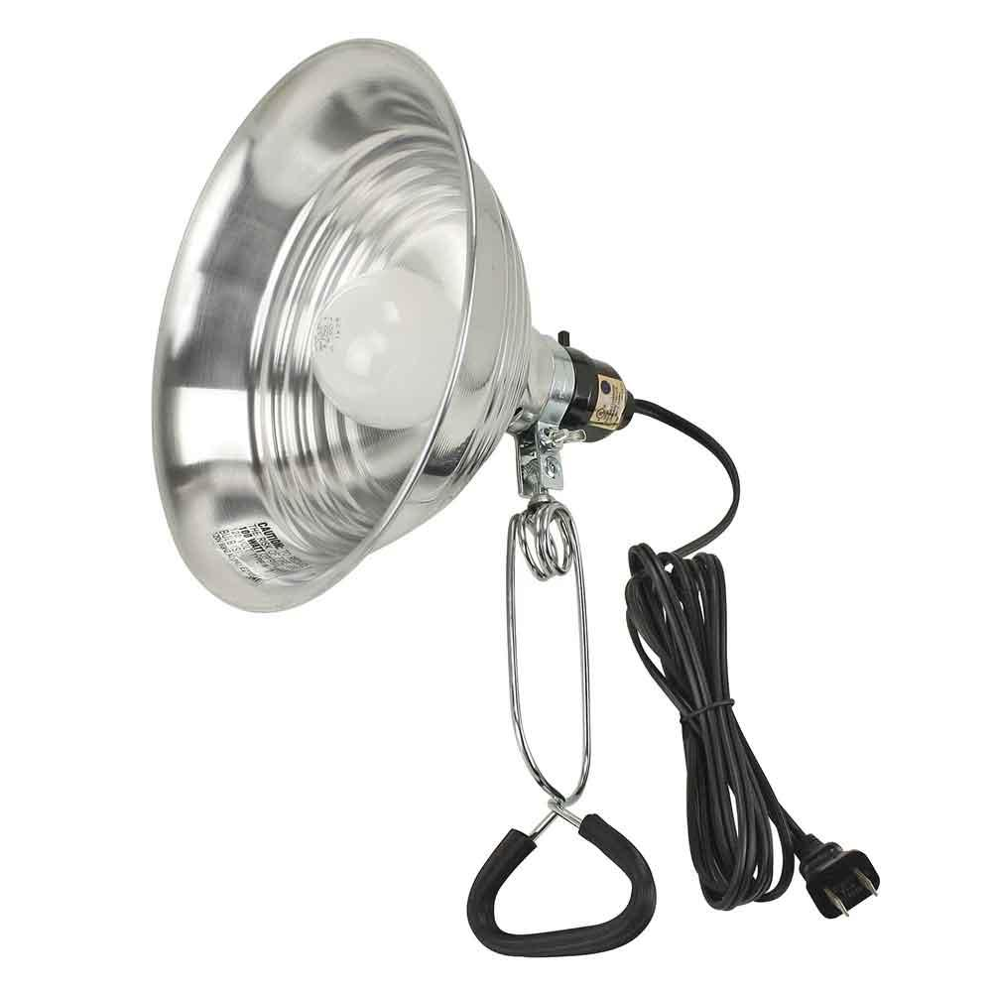
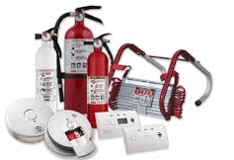
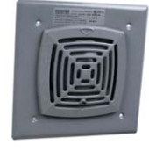
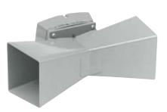
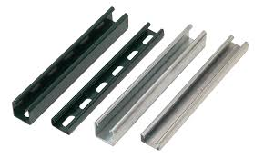
WE PROVIDE OUR CLIENTS WITH BUNDLED SOLUTIONS
Boxes & Fittings
Grounding & Bonding
Conduit
UL Listed Electrical Boxes, Fittings, Prefab Assemblies,
Nipples, Couplings & Spring Steel Fastener Products.
Ground Rods, Clamps and Lugs/Connectors.
Stainless Steel Conduit Systems, PVC Coated Conduit & Fittings, Elbows, Nipples & Couplings.
Transformers
Temporary
Power & Lighting
Tools
50VA to 5MVA Transformers, Control, Low & Medium Voltage Distribution, and Line Reactors.
Electrical Tools, Voltage Testers, Pliers, Hand Tools for Bending, Pulling and Cutting.
High-Quality Lighting Solutions Used on Job Sites: String Light/ Temporary Job Lighting.
Safety
Signals
Strut
Smoke & Carbon Monoxide Detectors, Fire Extinguisher Products.
Electronic Audible and Visual Signals for Indoor, Outdoor,
and Hazardous Locations.
Spring Steel Fasteners, Brackets, Fittings and Accessories.

